Slide 1

NFL vs. NCAA
NLP Project
By
Niphon C. and Supadit W.

Slide 2

Reddit
Reddit is a network of communities where people can dive into their interests, hobbies and passions

Slide 3
NFL : National Football League
NCAA : National Collegiate Athletic Association

Slide 4
Professional or College? Guess which is the source of these posts?
Do you agree with this top 5 WRs coming into the 2022 NFL Draft?
See how former Alabama star is doing so far in the NFL entering his 3rd season
Jordan Stout's 2nd punt is a short hanging 41 yard ball, neutral at best. Stout continues to underwhelm after a great preseason and college career
If you have a second, quick 2 question survey on preferred number of commentators for sports
Party is on Boone, NC
What better way to represent your team then with a fresh pair of sneakers!

Slide 5
Professional or College? Guess which is the source of these posts?
Do you agree with this top 5 WRs coming into the 2022 NFL Draft?
See how former Alabama star is doing so far in the NFL entering his 3rd season
Jordan Stout's 2nd punt is a short hanging 41 yard ball, neutral at best. Stout continues to underwhelm after a great preseason and college career
NFL
NCAA
If you have a second, quick 2 question survey on preferred number of commentators for sports
Party is on Boone, NC
What better way to represent your team then with a fresh pair of sneakers!
NFL & NCAA

Slide 6
PROBLEM statement
Posts are not mutually exclusive. Occasionally, there are discussions about NFL in NCAA threads both mistakenly or intentionally, and vice versa.
How do we automatically identify and detect unsuitable threads for a post and suggest a more suitable thread for our users?

Slide 7
Guiding questions
Are posts from NFL and NCAA communities different in term of words choice, length of post, special characters used ?
What are the best model and it’s hyperparameters to classify a post into NFL and NCAA thread?
How can we identify a potential post which could be not suitable for the community?

Slide 8
NLP project workflow
Reddit Data Requesting
EDA
Features Selection
Modeling and Evaluation
Loop requests ~900 posts
Drop duplicate rows
Mix and Match and Headache
Try everything that we could think of

Slide 9
Data Collection & EDA
Reddit Data Requesting
EDA
Features Selection
Modeling and Evaluation
NFL subreddit [1001] NCAA subreddit [976]
There are many null values in many columns
Drop duplicate data 1976 → 1611
Use only some features → ‘Title’ + ‘subreddit’

Slide 10
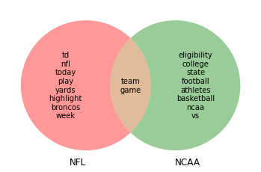
Data Collection & EDA
Reddit Data Requesting
EDA
Features Selection
Modeling and Evaluation
Drop top 10 most common words in each subreddit:
NFL = ['highlight’, 'game’, 'nfl’, 'yards’, 'td’, 'week’, 'play’, 'today’, 'broncos’, 'team’]
NCAA = ['ncaa’, 'college’, 'athletes’ , 'football’, 'state’,
'vs’, 'basketball’, 'team', 'game',
'eligibility']

Slide 11
Model journey
With Redbull and Headache
Reddit Data Requesting
EDA
Features Selection
Modeling and Evaluation

Slide 12
Pipeline and Params
Transformer | Estimators
CounterVectorizer | LogisticRegression
TfidfVectorizer | NaiveBayes
 | RandomForest
Hyperparameters | Values
max features | Range(100,1001,100)
stop words | None and English
n_grams | Unigram, Bigram, and Trigram

Slide 13
‘Title’
‘Title’ + drop 20 frequent words
‘Title’ + drop 20 frequent words + Lemmatization
Quantitative Properties of ‘Title’ + Logistic Regression
Slightly overfit (~4%)
More overfitting (~7%)
Most overfitting (~12%)
Least overfit (~2%)
Least Predictive power (69%)
Most Predictive power (~93%)
Lesser Predictive power (~89%)
Lesser Predictive power (~82%)
Pipeline and GridSearch
Logistic Regression

Slide 14
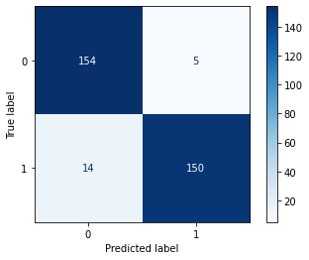

First Model
CountVectorizer + LogisticRegression
Features: ‘Title’ no words dropping
Best Score: 0.9394 | Slightly overfit (~4%)
Best Params: max_features=900 + bigram + English stopwords
Error Analysis
Hypothesis: Sharing word ‘game’ in both NFL and NCAA
$\frac{FN}{TN}= \frac{14}{150} ≈9.33\% | \frac{game, team}{All words}≈19.62$%

Slide 15
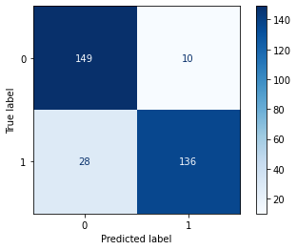
Second Model
TfidfVectorizer + LogisticRegression
Features: ‘Title’ + frequent 20 words dropping (including NFL and NCAA )
Best Score: 0.8947 | More overfitting (~7%)
Best Params: max_features=900 + unigram + English stopwords
Error Analysis
Hypothesis: - After observing False Negative rows, we noticed that there are specific names that our model might not weighted it strong enough to be predictive

Slide 16
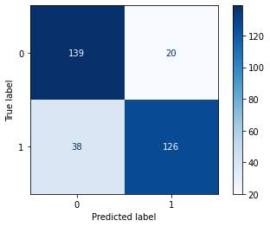
Third model
TfidfVectorizer + LogisticRegression
Features: ‘Title’ + frequent 20 words dropping + lemmatizing
Best Score: 0.8204
Best Params: max_features=1000 + unigram + English stopwords
Error Analysis
Hypothesis: - Error seems to be the same with Second Model and Lemmatizing make prediction harder for the model

Slide 17
What should be done for prior three models
Specific words dictionary → Time consuming and require experience from expert domain
Computer can’t understand important words until we teach them which words should be weighted more than others
Yet, too much specification will cause overfitting or misprediction in some case
GridSearch suggest HIGH max _features → More data should be collected
MOOOORRRREEEEEE
We got ~1600 rows and they required ~1000 frequent words
With this requirement, we decided to take another turn on modeling

Slide 18
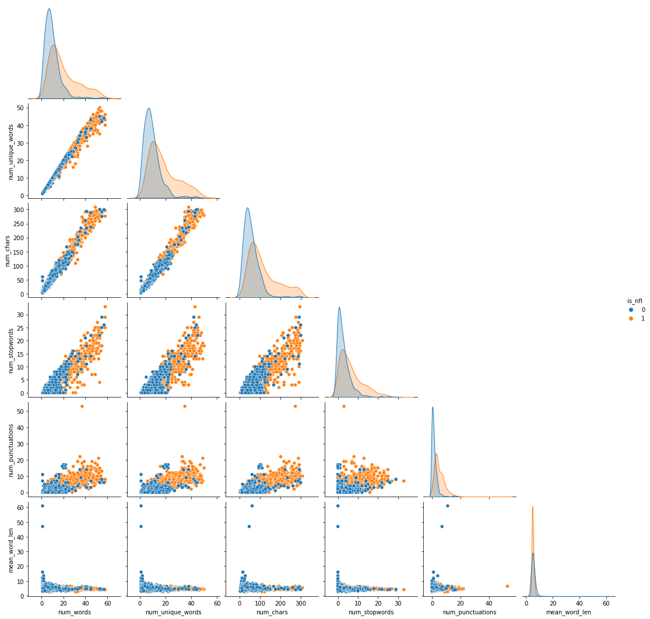
Fourth model
Logistic Regression
Features: quantitative values extracting of ‘title’
(NO TEXT DATA)
number of words
number of unique words
number of characters
number of stopwords
number of punctuations
average word length
Posts from NFL thread are usually longer than those from NCAA thread
Average length of words are relatively the same

Slide 19
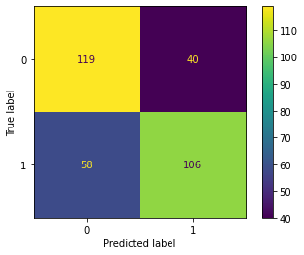
Fourth model
Logistic Regression
Features: quantitative values extracting of ‘Title’
Score: 0.6965
Highest coefficient: number of words
Error Analysis
Usually wrongly classified short posts as NCAA and long posts as NFL
Using only quantitative values might not be great option with text data analysis, but there is no overfitting

Slide 20
Conclusions
Using logistic regression model with Tfidf Vectorizer on texts from the posts from two subreddit threads, we can classify an unlabeled post into NFL and NCAA thread with accuracy of 89.47%.
Using logistic regression classifier model on texts from quantitative features extracting from texts is acceptable alternative approach, we can classify an unlabeled post into NFL and NCAA thread with accuracy of 69.65%.
‘Title’
‘Title’ + drop 20 frequent words
‘Title’ + drop 20 frequent words + Lemmatization
Quantitative Properties of ‘Title’ + Logistic Regression

Slide 21
Suggestions and Future works
Explore classification models using combination features of texts and quantitative features extracting from texts.
Explore more advanced classification models such as BERT
Collect more data about inappropriate threads of posts to better develop model that can automatically detect unsuitable threads for a post and suggest a more suitable thread.
After further tuning with the model, we will code a suggestion bot to suggest users if their threads is not quite match certain subreddit.

Slide 22
THANK YOU

